Slide 1
Multi-Period Optimal Power Flow (MP-OPF) for Active Distribution Systems (ADS)
Team WSU
Slides created by
Aryan Ritwajeet Jha, Graduate Research Assistant¹
Anup Parajuli, Graduate Research Assistant¹
Under the supervision of Dr. Anamika Dubey, Associate Professor¹
¹ Energy Systems Innovation Center, School of Electrical Engineering and Computer Science, Voiland College of Engineering, Washington State University, Pullman
Notes:
Remember to hit the reset button to make sure all the page elements react properly.
There are 20 different layouts that you can choose from.

Slide 2
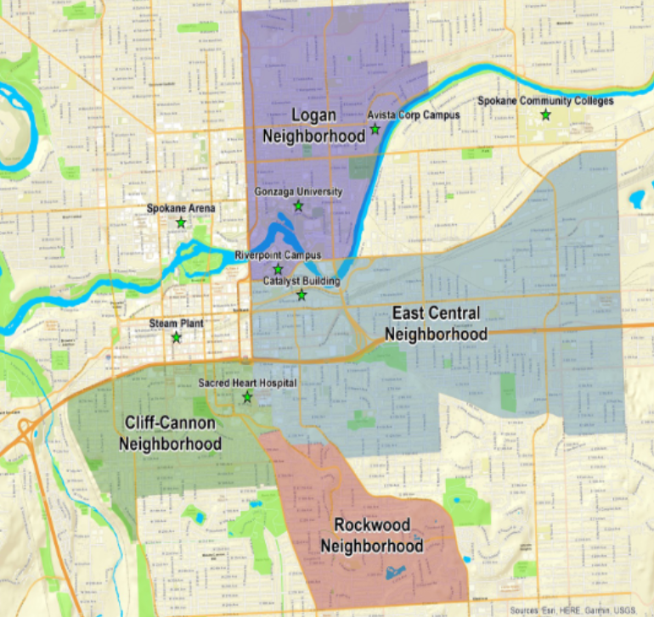




Quick Overview of Team WSU’s objectives for the Spokane Connected Communities Project [CC1, CC2]
Developing an optimal control scheme for a distribution feeder with renewables and ‘flexibility-offering’ Edo nodes to optimize a desired objective.
Steps involved:
Development of mathematical models which can realistically model the components of the system along the lines of known optimization frameworks which can be programmatically solved for.
Development and implementation of decomposition algorithms which can enable the optimization problem to be solved in faster times.
Validation of optimization algorithm results against known trusted distribution system simulator solutions such as OpenDSS [OD].

Slide 3

Quick Overview of the contents of this presentation
Brief overview of WSU’s Test Network Configuration
Explanation of the modelling of specific system components in the optimization algorithm followed by the complete Balanced Three-Phase Nonlinear model
Explanation of the procedure required for the Distributed OPF algorithm followed by a comparison of its results vs the Centralized OPF algorithm
Quick overview of the Linear Unbalanced Three-Phase Model and results for the Centralized OPF algorithm

Slide 4
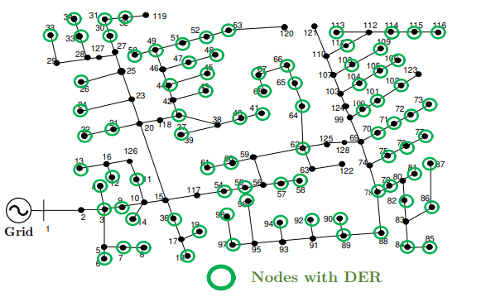
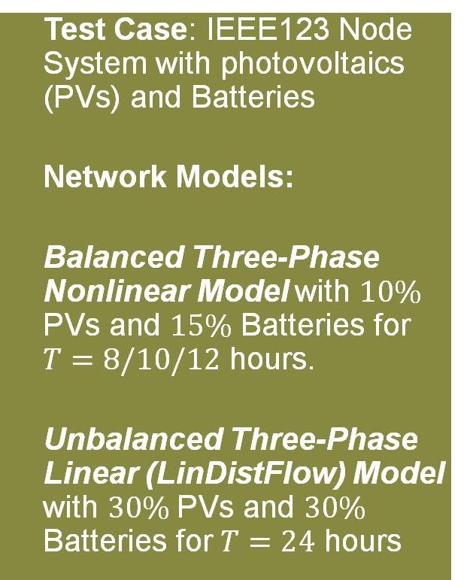
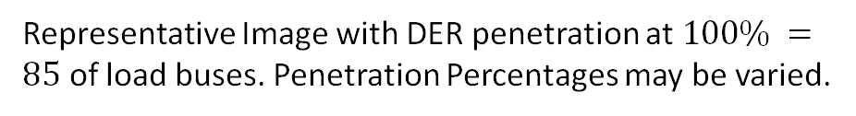
WSU’s Test Network
Test Case: IEEE123 Node System with photovoltaics (PVs) and Batteries
Network Models:
Balanced Three-Phase Nonlinear Model with $10\%$ PVs and $15\%$ Batteries for $T=8/10/12$ hours.
Unbalanced Three-Phase Linear (LinDistFlow) Model with $30\%$PVs and $30\%$ Batteries for $T=24$ hours
Representative Image with DER penetration at $100\% =85$ of load buses. Penetration Percentages may be varied.

Slide 5
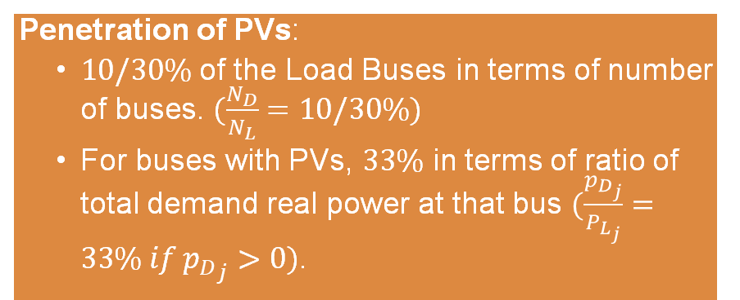
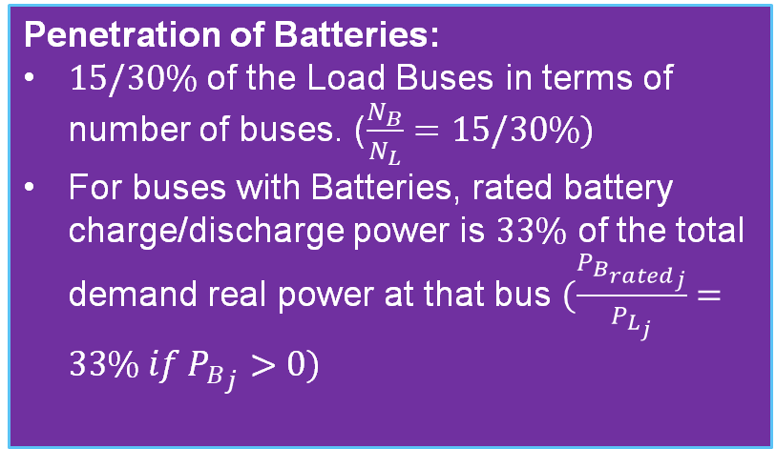
WSU’s Test Network (contd.)
Penetration of PVs:
$10/30\%$ of the Load Buses in terms of number of buses. $(\frac{N_{D}}{N_{L}}=10/30\%)$
For buses with PVs, $33\%$ in terms of ratio of total demand real power at that bus $(\frac{p_{D_{j}}}{P_{L_{j}}}=33\% if {p_{D}}_{j}>0)$.
Penetration of Batteries:
$15/30\%$ of the Load Buses in terms of number of buses. ($\frac{N_{B}}{N_{L}}=15/30\%)$
For buses with Batteries, rated battery charge/discharge power is $33\%$ of the total demand real power at that bus $(\frac{P_{{B_{rated}}_{j}}}{P_{L_{j}}}=33\% if {P_{B}}_{j}>0)$

Slide 6
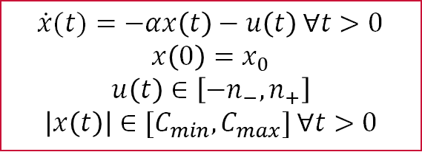
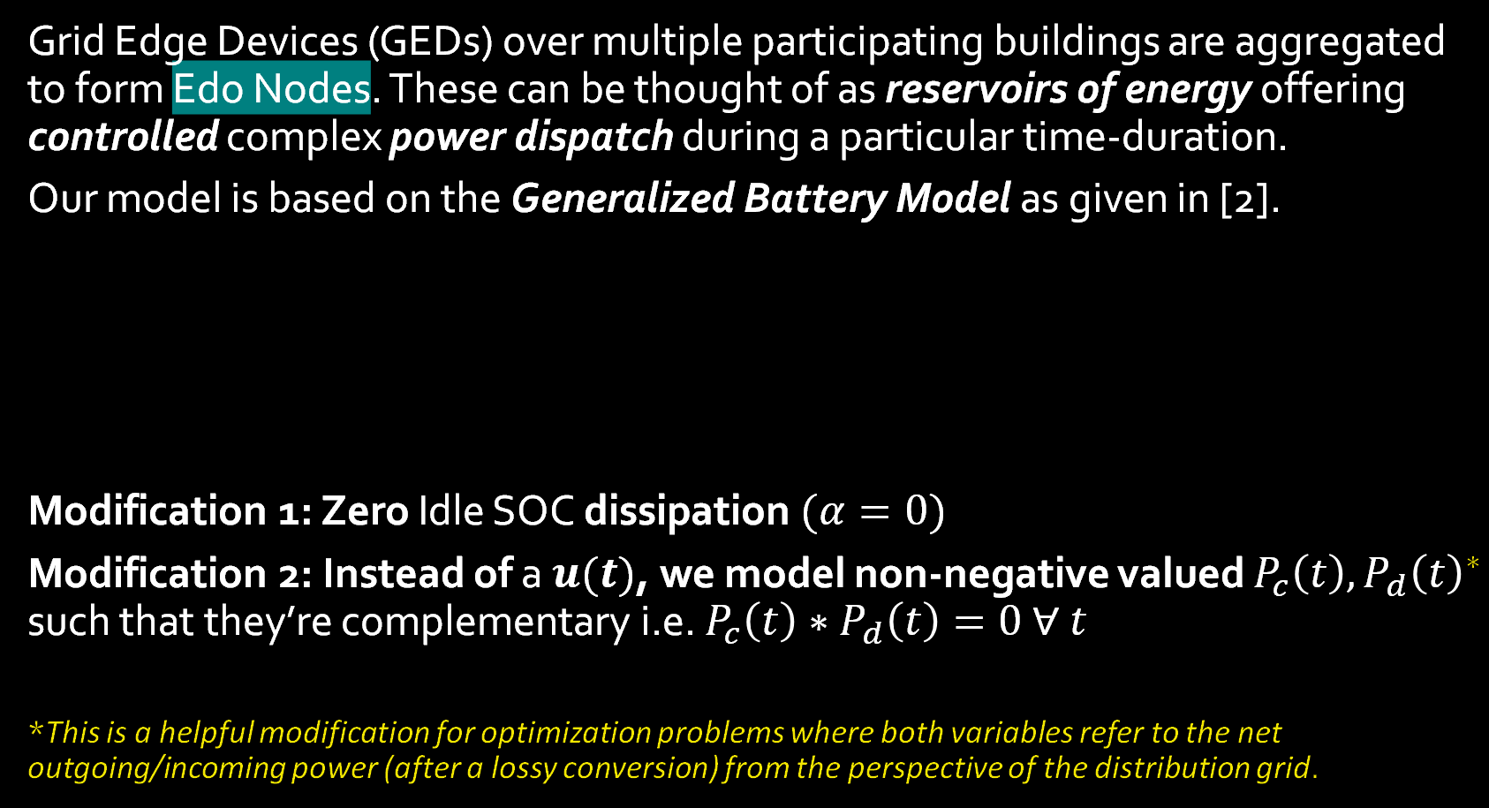
Modelling Edo Nodes as Storage
Grid Edge Devices (GEDs) over multiple participating buildings are aggregated to form Edo Nodes. These can be thought of as reservoirs of energy offering controlled complex power dispatch during a particular time-duration.
Our model is based on the Generalized Battery Model as given in [2].
Modification 1: Zero Idle SOC dissipation $(α=0)$
Modification 2: Instead of a $u(t)$, we model non-negative valued $P_{c}\left(t\right), P_{d}{\left(t\right)}^{∗}$ such that they’re complementary i.e. $P_{c}\left(t\right)∗P_{d}\left(t\right)=0 ∀ t$
*This is a helpful modification for optimization problems where both variables refer to the net outgoing/incoming power (after a lossy conversion) from the perspective of the distribution grid.
$\dot{x}(t)=−αx\left(t\right)−u\left(t\right)$ $∀t>0$
$x\left(0\right)=x_{0}$
$$u\left(t\right)∈\left[−n_{−}, n_{+}\right]$$
$\left|x\left(t\right)\right|∈[C_{min}, C_{max}]$ $∀t>0$
Battery SOC Equation
Initial SOC
Charging/Discharging Limits
SOC Limits

Slide 7
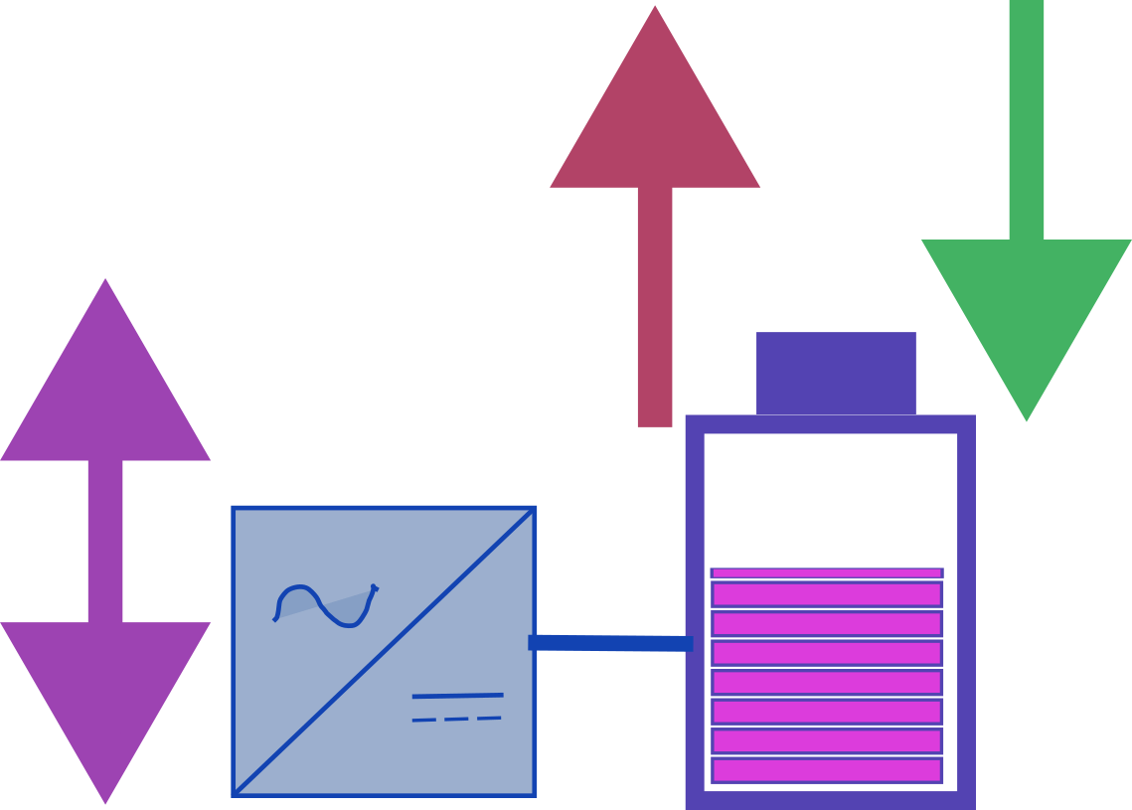
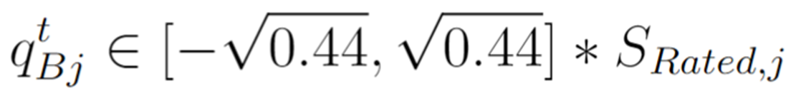
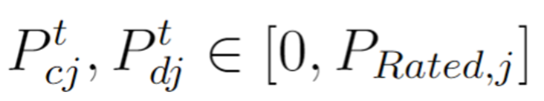
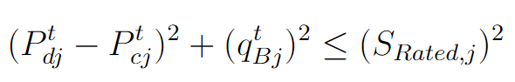
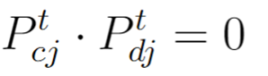

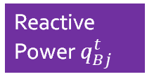





Edo-Node Modelling
as Battery with Inverter
Note: Values here are typical in OPF literature [2, 3]
Discharging Power $P_{dj}^{t}$
Charging Power $P_{cj}^{t}$
Reactive Power $q_{Bj}^{t}$
Battery SOC $B_{j}^{t}$
Relationships between the battery rated powers and inverter rating
Inverter Rating ${S_{Rated}}_{j}$
Typical $P_{Ratedj}∈\left[5, 40\right]$ kW
Typically, $P_{Ratedj}=\frac{1}{3}∗P_{Loadj}$
Complementarity Constraint
Typical $q_{Ratedj}∈\left[1, 10\right]$ kVAr
Typically, $q_{Ratedj}=\frac{1}{3}∗Q_{Loadj}$

Slide 8
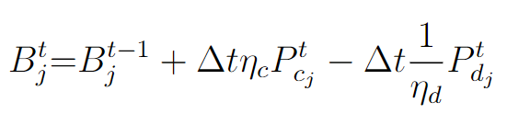

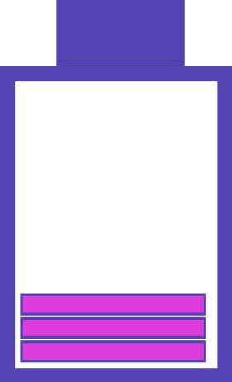
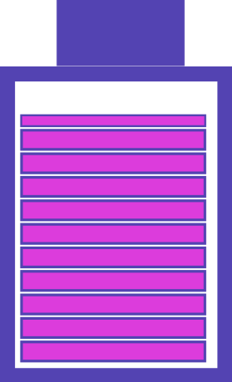
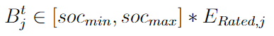
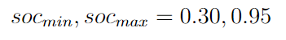
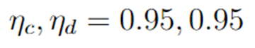
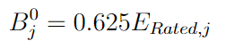
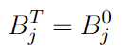
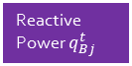
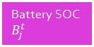

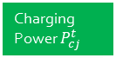

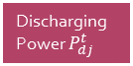


Edo-Node Modelling
as Battery with Inverter
Note: Values here are typical in OPF literature [2, 3]
Discharging Power $P_{dj}^{t}$
Charging Power $P_{cj}^{t}$
Battery SOC Equation
Reactive Power $q_{Bj}^{t}$
Battery SOC $B_{j}^{t}$
Inverter Rating ${S_{Rated}}_{j}$
$$∈($$
$$,$$
$$)$$
Battery SOC Limits
Battery SOC Limits
Charging/Discharging Efficiencies
Initial SOC
After full horizon:
Terminal SOC constraint

Slide 9
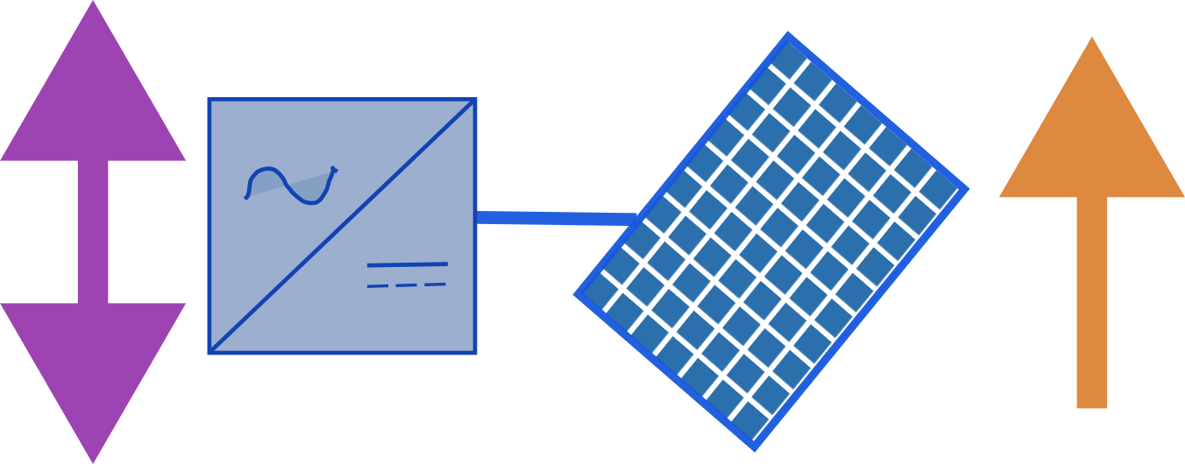
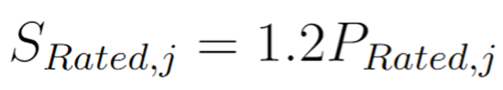
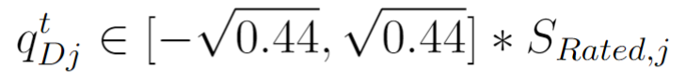
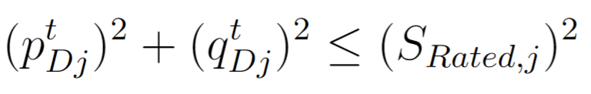




Solar PVs with Inverters
PV Real Power $P_{Dj}^{t}$
Reactive Power $q_{Dj}^{t}$
Inverter Rating ${S_{Rated}}_{j}$
Relationships between the rated powers
Typical $P_{Ratedj}∈\left[5, 40\right]$ kW
Typically, $P_{Ratedj}=\frac{1}{3}∗P_{Loadj}$
Typical $q_{Ratedj}∈\left[1, 10\right]$ kVAr
Typically, $q_{Ratedj}=\frac{1}{3}∗Q_{Loadj}$
Solar Inverter Rating Limit

Slide 10
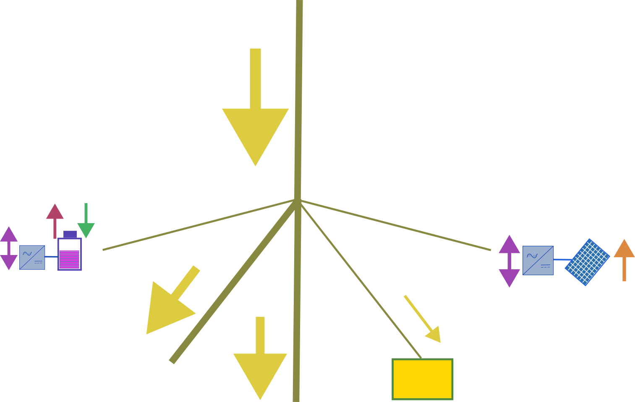
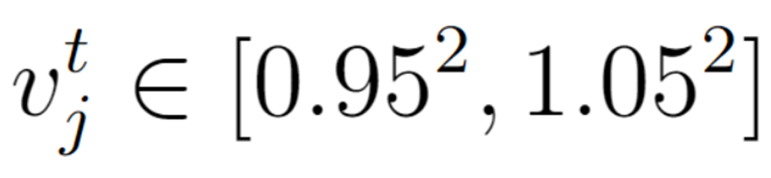
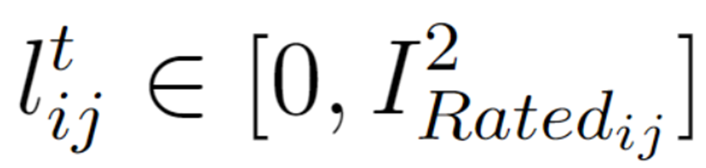
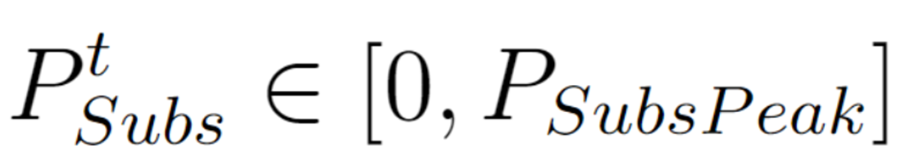







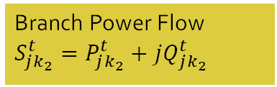
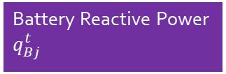






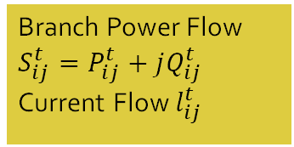
Bus $i$:$v_{i}^{t}={\left(V_{i}^{t}\right)}^{2}$
Network Constraints – Branch Flow Model
Branch Power Flow $S_{ij}^{t}=P_{ij}^{t}+jQ_{ij}^{t}$
Current Flow $l_{ij}^{t}$
Branch $(i, j)$
Discharging Power $P_{dj}^{t}$
Charging Power $P_{cj}^{t}$
Bus $j$:$v_{j}^{t}={\left(V_{j}^{t}\right)}^{2}$
PV Real Power $P_{Dj}^{t}$
Battery Reactive Power $q_{Bj}^{t}$
Branch $(j, k_{1})$
Branch $(j, k_{2})$
PV Reactive Power $q_{Dj}^{t}$
Bus $k_{1}$
Engineering Constraints
Branch Power Flow $S_{jk_{1}}^{t}=P_{jk_{1}}^{t}+jQ_{jk_{1}}^{t}$
Bus $k_{2}$
Load $P_{Lj}^{t}+jQ_{Lj}^{t}$
Branch Power Flow $S_{jk_{2}}^{t}=P_{jk_{2}}^{t}+jQ_{jk_{2}}^{t}$
No backflow allowed
Optionally, Peak Satisfiable Demand may be specified as well

Slide 11
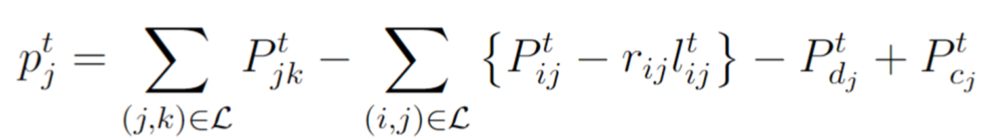
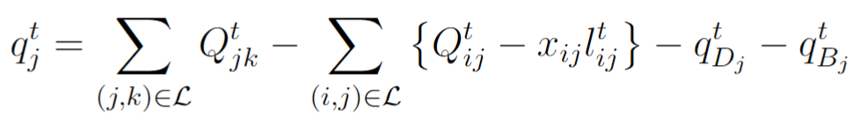
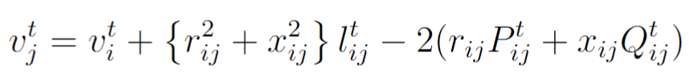
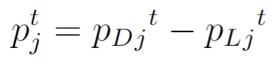
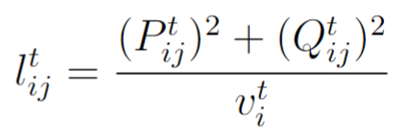
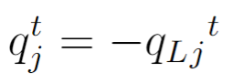
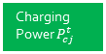




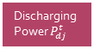
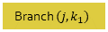

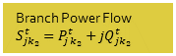





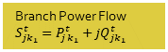




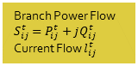

Bus $i$:$v_{i}^{t}={\left(V_{i}^{t}\right)}^{2}$
Network Constraints – Branch Flow Model
Branch Power Flow $S_{ij}^{t}=P_{ij}^{t}+jQ_{ij}^{t}$
Current Flow $l_{ij}^{t}$
Branch $(i, j)$
Discharging Power $P_{dj}^{t}$
Charging Power $P_{cj}^{t}$
Bus $j$:$v_{j}^{t}={\left(V_{j}^{t}\right)}^{2}$
Node $j$ Real Power Balance
PV Real Power $P_{Dj}^{t}$
Battery Reactive Power $q_{Bj}^{t}$
Branch $(j, k_{1})$
Branch $(j, k_{2})$
PV Reactive Power $q_{Dj}^{t}$
Node $j$ Reactive Power Balance
Bus $k_{1}$
Branch Power Flow $S_{jk_{1}}^{t}=P_{jk_{1}}^{t}+jQ_{jk_{1}}^{t}$
Bus $k_{2}$
Load $P_{Lj}^{t}+jQ_{Lj}^{t}$
Branch Power Flow $S_{jk_{2}}^{t}=P_{jk_{2}}^{t}+jQ_{jk_{2}}^{t}$
KVL across branch $(i, j)$
Net Generation at Node $j$
Current Magnitude across branch $(i, j)$

Slide 12
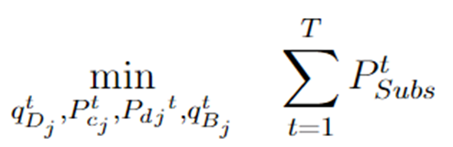






Bus $i$:$v_{i}^{t}={\left(V_{i}^{t}\right)}^{2}$
Full Optimization Model – Balanced Three-Phase Nonlinear OPF
Branch Power Flow $S_{ij}^{t}=P_{ij}^{t}+jQ_{ij}^{t}$
Current Flow $l_{ij}^{t}$
Branch $(i, j)$
Discharging Power $P_{dj}^{t}$
Charging Power $P_{cj}^{t}$
Bus $j$:$v_{j}^{t}={\left(V_{j}^{t}\right)}^{2}$
PV Real Power $P_{Dj}^{t}$
$min.$Desired Objective Function, (appended with an SCD penalty function)
Battery Reactive Power $q_{Bj}^{t}$
Substation Power
Branch $(j, k_{1})$
Branch $(j, k_{2})$
PV Reactive Power $q_{Dj}^{t}$
$$subject to$$
Bus $k_{1}$
Network Constraints
Branch Power Flow $S_{jk_{1}}^{t}=P_{jk_{1}}^{t}+jQ_{jk_{1}}^{t}$
Bus $k_{2}$
Load $P_{Lj}^{t}+jQ_{Lj}^{t}$
Cost of Substation Power
Engineering Constraints
Branch Power Flow $S_{jk_{2}}^{t}=P_{jk_{2}}^{t}+jQ_{jk_{2}}^{t}$
Component Constraints (DERs, Batteries)
Voltage Deviation
Line Losses
Peak Shaving Constraint
SCD Penalty Function – Ensures that Simultaneous Charging and Discharging for any Battery never occurs

Slide 13



Network being tested on
ENApp Approach [1]
Divide the network into several areas to solve for their Optimal Power Flow solutions separately, with exchange of boundary variables after every ‘macro-iteration’.

Slide 14

Communication Architecture for MP-DOPF Algorithm
Types of Communication Involved:
OpenDSO-System Operator (Forecast)
OpenDSO-Measurement Devices
OpenDSO-EDO
OpenDSO-OpenDSO

Slide 15

A simple schematic for D-OPF.

Slide 16

Extension of DOPF to Multi-Period
Start
--------------------------------------------
Known:
$B_{j}^{0}, P_{DER_{j}}^{t}, P_{Load_{j}}^{t} ∀ t∈\left[0, T\right], j∈Ν$
---------------------------------------------
while “(Spatial) boundary variables are NOT equal in value for all connected parent-child areas”
Run OPF for minimizing the losses across the horizon for each area, in parallel. This is called as a macro-iteration.
Exchange (spatial) boundary variables between all sets of connected parent-child areas.
end
-----------------------------------------------
Stop

Slide 17


Extending the MP-D-OPF to three time-steps
($T=3)$: The actual process

Slide 18


A simpler schematic for MP-D-OPF for three time-steps
($T=3)$: The decomposed computation paradigm for a single macro-iteration
In one Macro-iteration, each of these ‘green boxes’ is solved for OPF once. Once all boxes are solved, boundary variables are exchanged between each pair of connected areas. This completes a Macro-iteration.

Slide 19






Note: In one Macro-iteration, each of these green boxes is solved. Once all boxes are solved, boundary variables are exchanged between each pair of connected areas. This completes a Macro-iteration.
A simpler schematic for MP-D-OPF for three time-steps
($T=3)$
Start
--------------------------------------------
Known:
$B_{j}^{0}, P_{DER_{j}}^{t}, P_{Load_{j}}^{t} ∀ t∈\left[0, T\right], j∈Ν$
---------------------------------------------
while “(Spatial) boundary variables are still updating in value for all connected parent- child areas across all time-steps”
end
-----------------------------------------------
Stop
Each line represent a particular Boundary Variable at a specific time-step. Its trajectory ($y$-axis values vs $x$-axis values) represent its convergence with each macro-iteration.
[Perform 1 MP-DOPF Macro-iteration.]
Solve for OPF for each green box.
if Boundary Variables Converged
Stop.
else
Exchange Boundary Variables
$$macroItr+=1$$
end
For example, the sky blue line in these plots represents the convergence of the Complex Power exchange (above) and Squared Nodal Voltage (below) at the Point of Coupling between Areas 1 and 2 during the third hour.

Slide 20






MPCOPF Verified for $T=12, PV=10\%, Batt=15\%$
strLoadShape = 'New Loadshape.LoadShape npts =12 interval = 1 mult = [0.644 0.668 0.705 0.75 0.777 0.787 0.796 0.782 0.783 0.789 0.826 0.855]'
strLoadShapePV = 'New Loadshape.LoadShapePV npts =12 interval = 1 mult = [0.1 0.2 0.3 0.5 0.8 0.9 1 1 0.99 0.9 0.7 0.4]'
OpenDSS Def Profiles
Line Losses
OpenDSS Powerflow Results
MPDOPF Simulation Results
Timings
Discrepancies
~$6$ hours

Slide 21






MPDOPF Verified for $T=12, PV=10\%, Batt=15\%$
strLoadShape = 'New Loadshape.LoadShape npts =12 interval = 1 mult = [0.644 0.668 0.705 0.75 0.777 0.787 0.796 0.782 0.783 0.789 0.826 0.855]'
strLoadShapePV = 'New Loadshape.LoadShapePV npts =12 interval = 1 mult = [0.1 0.2 0.3 0.5 0.8 0.9 1 1 0.99 0.9 0.7 0.4]'
OpenDSS Def Profiles
Line Losses
MPDOPF Simulation Results
OpenDSS Powerflow Results
Timings
Discrepancies
~$23$ minutes

Slide 22





MPCOPF Verified for $T=12, PV=10\%, Batt=15\%$
strLoadShape = 'New Loadshape.LoadShape npts =12 interval = 1 mult = [0.644 0.668 0.705 0.75 0.777 0.787 0.796 0.782 0.783 0.789 0.826 0.855]'
strLoadShapePV = 'New Loadshape.LoadShapePV npts =12 interval = 1 mult = [0.1 0.2 0.3 0.5 0.8 0.9 1 1 0.99 0.9 0.7 0.4]'
Confirmation of Complementarity of Charging and Discharging (or equivalently, confirmation that no SCD is happening)
Line Losses
OpenDSS Def Profiles

Slide 23





MPDOPF Verified for $T=12, PV=10\%, Batt=15\%$
strLoadShape = 'New Loadshape.LoadShape npts =12 interval = 1 mult = [0.644 0.668 0.705 0.75 0.777 0.787 0.796 0.782 0.783 0.789 0.826 0.855]'
strLoadShapePV = 'New Loadshape.LoadShapePV npts =12 interval = 1 mult = [0.1 0.2 0.3 0.5 0.8 0.9 1 1 0.99 0.9 0.7 0.4]'
Confirmation of Complementarity of Charging and Discharging (or equivalently, confirmation that no SCD is happening)
Line Losses
OpenDSS Def Profiles

Slide 24




strLoadShape = 'New Loadshape.LoadShape npts =12 interval = 1 mult = [0.644 0.668 0.705 0.75 0.777 0.787 0.796 0.782 0.783 0.789 0.826 0.855]'
MPDOPF Verified for $T=12, PV=10\%, Batt=15\%$
strLoadShapePV = 'New Loadshape.LoadShapePV npts =12 interval = 1 mult = [0.1 0.2 0.3 0.5 0.8 0.9 1 1 0.99 0.9 0.7 0.4]'
Convergence of Boundary Complex Powers with every macro-iteration
OpenDSS Def Profiles
Line Losses

Slide 25



Convergence of Boundary Voltages with every macro-iteration
strLoadShape = 'New Loadshape.LoadShape npts =12 interval = 1 mult = [0.644 0.668 0.705 0.75 0.777 0.787 0.796 0.782 0.783 0.789 0.826 0.855]'
MPDOPF Verified for $T=12, PV=10\%, Batt=15\%$
strLoadShapePV = 'New Loadshape.LoadShapePV npts =12 interval = 1 mult = [0.1 0.2 0.3 0.5 0.8 0.9 1 1 0.99 0.9 0.7 0.4]'
OpenDSS Def Profiles
Line Losses

Slide 26











MPCOPF Verified for $T=5, PV=10\%, Batt=15\%$
strLoadShape = 'New Loadshape.LoadShape npts =5 interval = 1 mult = [0.75 0.777 0.787 0.796 0.782]'
strLoadShapePV = 'New Loadshape.LoadShapePV npts =5 interval = 1 mult = [0.5 0.8 0.9 1 1]'
$P_{Subs}^{t}$
$P_{SubsCost}^{t}$
OpenDSS Def Profiles
Line Losses
OpenDSS Powerflow Results
$$P_{Loss}^{t}$$
MPDOPF Simulation Results
Objective
$$P_{SubsPeak}$$
Discrepancies
Timings

Slide 27







MPDOPF Verified for $T=5, PV=10\%, Batt=15\%$
strLoadShape = 'New Loadshape.LoadShape npts =5 interval = 1 mult = [0.75 0.777 0.787 0.796 0.782]'
strLoadShapePV = 'New Loadshape.LoadShapePV npts =5 interval = 1 mult = [0.5 0.8 0.9 1 1]'
$P_{Subs}^{t}$
$P_{SubsCost}^{t}$
OpenDSS Def Profiles
Line Losses
OpenDSS Powerflow Results
$$P_{Loss}^{t}$$
MPDOPF Simulation Results
Objective
$$P_{SubsPeak}$$
Timings
Discrepancies

Slide 28





MPCOPF Verified for $T=5, PV=10\%, Batt=15\%$
strLoadShape = 'New Loadshape.LoadShape npts =5 interval = 1 mult = [0.75 0.777 0.787 0.796 0.782]'
strLoadShapePV = 'New Loadshape.LoadShapePV npts =5 interval = 1 mult = [0.5 0.8 0.9 1 1]'
Confirmation of Complementarity of Charging and Discharging (or equivalently, confirmation that no SCD is happening)
OpenDSS Def Profiles
Line Losses

Slide 29




MPDOPF Verified for $T=5, PV=10\%, Batt=15\%$
strLoadShape = 'New Loadshape.LoadShape npts =5 interval = 1 mult = [0.75 0.777 0.787 0.796 0.782]'
strLoadShapePV = 'New Loadshape.LoadShapePV npts =5 interval = 1 mult = [0.5 0.8 0.9 1 1]'
Confirmation of Complementarity of Charging and Discharging (or equivalently, confirmation that no SCD is happening)
OpenDSS Def Profiles
Line Losses

Slide 30






MPCOPF Verified for $T=5, PV=10\%, Batt=15\%$
strLoadShape = 'New Loadshape.LoadShape npts =5 interval = 1 mult = [0.75 0.777 0.787 0.796 0.782]'
strLoadShapePV = 'New Loadshape.LoadShapePV npts =5 interval = 1 mult = [0.5 0.8 0.9 1 1]'
$P_{Subs}^{t}$
$P_{SubsCost}^{t}$
OpenDSS Def Profiles
Line Losses + Peak Shave
OpenDSS Powerflow Results
$$P_{Loss}^{t}$$
MPDOPF Simulation Results
Objective
$$P_{SubsPeak}$$
Timings
Discrepancies

Slide 31






MPDOPF Verified for $T=5, PV=10\%, Batt=15\%$
strLoadShape = 'New Loadshape.LoadShape npts =5 interval = 1 mult = [0.75 0.777 0.787 0.796 0.782]'
strLoadShapePV = 'New Loadshape.LoadShapePV npts =5 interval = 1 mult = [0.5 0.8 0.9 1 1]'
$P_{Subs}^{t}$
$P_{SubsCost}^{t}$
OpenDSS Def Profiles
Line Losses + Peak Shave
OpenDSS Powerflow Results
$$P_{Loss}^{t}$$
MPDOPF Simulation Results
Objective
$$P_{SubsPeak}$$
Timings
Discrepancies

Slide 32


MPCOPF Verified for $T=5, PV=10\%, Batt=15\%$
strLoadShape = 'New Loadshape.LoadShape npts =5 interval = 1 mult = [0.75 0.777 0.787 0.796 0.782]'
strLoadShapePV = 'New Loadshape.LoadShapePV npts =5 interval = 1 mult = [0.5 0.8 0.9 1 1]'
Confirmation of Complementarity of Charging and Discharging (or equivalently, confirmation that no SCD is happening)
OpenDSS Def Profiles
Line Losses + Peak Shave

Slide 33

MPDOPF Verified for $T=5, PV=10\%, Batt=15\%$
strLoadShape = 'New Loadshape.LoadShape npts =5 interval = 1 mult = [0.75 0.777 0.787 0.796 0.782]'
strLoadShapePV = 'New Loadshape.LoadShapePV npts =5 interval = 1 mult = [0.5 0.8 0.9 1 1]'
Confirmation of Complementarity of Charging and Discharging (or equivalently, confirmation that no SCD is happening)
OpenDSS Def Profiles
Line Losses + Peak Shave

Slide 34






MPCOPF Verified for $T=5, PV=10\%, Batt=15\%$
strLoadShapeCost = 'New Loadshape.LoadShapeCost npts =5 interval = 1 mult = [0.048204 0.048204 0.30181 0.30181 0.048204]'
$P_{Subs}^{t}$
$P_{SubsCost}^{t}$
OpenDSS Def Profiles
Gen Cost
OpenDSS Powerflow Results
$$P_{Loss}^{t}$$
MPDOPF Simulation Results
Objective
$$P_{SubsPeak}$$
Timings
Discrepancies

Slide 35






MPDOPF Verified for $T=5, PV=10\%, Batt=15\%$
strLoadShapeCost = 'New Loadshape.LoadShapeCost npts =5 interval = 1 mult = [0.048204 0.048204 0.30181 0.30181 0.048204]'
$P_{Subs}^{t}$
$P_{SubsCost}^{t}$
OpenDSS Def Profiles
Gen Cost
OpenDSS Powerflow Results
$$P_{Loss}^{t}$$
MPDOPF Simulation Results
Objective
$$P_{SubsPeak}$$
Timings
Discrepancies

Slide 36




MPCOPF Verified for $T=5, PV=10\%, Batt=15\%$
strLoadShapeCost = 'New Loadshape.LoadShapeCost npts =5 interval = 1 mult = [0.048204 0.048204 0.30181 0.30181 0.048204]'
Confirmation of Complementarity of Charging and Discharging (or equivalently, confirmation that no SCD is happening)
OpenDSS Def Profiles
Gen Cost

Slide 37




MPDOPF Verified for $T=5, PV=10\%, Batt=15\%$
strLoadShapeCost = 'New Loadshape.LoadShapeCost npts =5 interval = 1 mult = [0.048204 0.048204 0.30181 0.30181 0.048204]'
Confirmation of Complementarity of Charging and Discharging (or equivalently, confirmation that no SCD is happening)
OpenDSS Def Profiles
Gen Cost

Slide 38






MPDOPF Verified for $T=5, PV=10\%, Batt=15\%$
strLoadShapeCost = 'New Loadshape.LoadShapeCost npts =5 interval = 1 mult = [0.048204 0.048204 0.30181 0.30181 0.048204]'
$P_{Subs}^{t}$
$P_{SubsCost}^{t}$
OpenDSS Def Profiles
Gen Cost + Peak Shave
OpenDSS Powerflow Results
$$P_{Loss}^{t}$$
MPDOPF Simulation Results
Objective
$$P_{SubsPeak}$$
Discrepancies
Timings

Slide 39







MPCOPF Verified for $T=5, PV=10\%, Batt=15\%$
strLoadShapeCost = 'New Loadshape.LoadShapeCost npts =5 interval = 1 mult = [0.048204 0.048204 0.30181 0.30181 0.048204]'
$P_{Subs}^{t}$
$P_{SubsCost}^{t}$
OpenDSS Def Profiles
Gen Cost + Peak Shave
OpenDSS Powerflow Results
$$P_{Loss}^{t}$$
MPDOPF Simulation Results
Objective
$$P_{SubsPeak}$$
Discrepancies
Timings

Slide 40




MPDOPF Verified for $T=5, PV=10\%, Batt=15\%$
strLoadShapeCost = 'New Loadshape.LoadShapeCost npts =5 interval = 1 mult = [0.048204 0.048204 0.30181 0.30181 0.048204]'
Confirmation of Complementarity of Charging and Discharging (or equivalently, confirmation that no SCD is happening)
OpenDSS Def Profiles
Gen Cost + Peak Shave

Slide 41




MPCOPF Verified for $T=5, PV=10\%, Batt=15\%$
strLoadShapeCost = 'New Loadshape.LoadShapeCost npts =5 interval = 1 mult = [0.048204 0.048204 0.30181 0.30181 0.048204]'
Confirmation of Complementarity of Charging and Discharging (or equivalently, confirmation that no SCD is happening)
OpenDSS Def Profiles
Gen Cost + Peak Shave

Slide 42






MPDOPF Verified for $T=12, PV=10\%, Batt=15\%$
$P_{Subs}^{t}$
$P_{SubsCost}^{t}$
OpenDSS Def Profiles
Gen Cost + Peak Shave
OpenDSS Powerflow Results
$$P_{Loss}^{t}$$
MPDOPF Simulation Results
Objective
$$P_{SubsPeak}$$
Timings
Discrepancies

Slide 43




MPDOPF Verified for $T=12, PV=10\%, Batt=15\%$
Confirmation of Complementarity of Charging and Discharging (or equivalently, confirmation that no SCD is happening)
OpenDSS Def Profiles
Gen Cost + Peak Shave

Slide 44


LinDist OPF: A Linear Modelling for Unbalanced Three-Phase Radial Networks
Assumptions:
Power loss in the branch is much smaller that actual branch power flow (Z_{jk}ℓ_{jk} << S_{jk})
Branch currents not included in power flow formulations (ℓ_{jk}=0)
Original OPF LinDist OPF
(Z_{jk}ℓ_{jk} << S_{jk})
Z_{jk}ℓ_{jk} << S_{jk}
ℓ_{jk}=0
S. H. Low, "Convex Relaxation of Optimal Power Flow—Part I: Formulations and Equivalence," in IEEE Transactions on Control of Network Systems, vol. 1, no. 1, pp. 15-27, March 2014, doi: 10.1109/TCNS.2014.2309732.

Slide 45




Overall Formulation with PV + Batteries
Real power Flow
Reactive power Flow
KVL
Box constraint on reactive power from DG
=0
Battery thermal limit
Battery S.O.C constraint
Battery charge limit constraint
Discharge power limit
charge power limit
Charge/discharge complementarity constraint
Nodal Voltage Limit

Slide 46


Battery complementarity constraint:
Modified Objective Function:
f(x) = Loss Minimization/ Cost Minimization
SCD fictitious energy loss, a =1e-3
No. of Variables
Phases | a | b | c
Number of lines | 91 | 79 | 88
Pij | 91 | 79 | 88
Qij | 91 | 79 | 88
V | 92 | 80 | 89
P(rated) of PV = 30KW.
S(rated) of PV inv = 36KVA
P(rated) of battery = 10KW.
S(rated) of battery inv = 12KVA
E(rated) = P(rated) of battery *4
B = [0.3 E(rated), 0.95 E(rated)]
Pd, Pc = [ 0, P(rated of battery)]
V_{min} = 0.95 p.u
V_{max} = 1.05 p.u
Initial s.o.c of each batteries = B_{min} = 30%
Total no. of der bus= 30
Total = 777
Phases | a | b | c
Q(der) | 30 | 30 | 30
Total no. of battery bus= 30
Total = 777+90=867
Phases | a | b | c
Pd | 30 | 30 | 30
Pc | 30 | 30 | 30
soc | 30 | 30 | 30
Total= 777+90+270 = 1137
N. Nazir, P. Racherla and M. Almassalkhi, "Optimal Multi-Period Dispatch of Distributed Energy Resources in Unbalanced Distribution Feeders," in IEEE Transactions on Power Systems, vol. 35, no. 4, pp. 2683-2692, July 2020

Slide 47






Loss Minimization
Line Loss saving = 1118 KW

Slide 48






Cost Minimization
Energy Cost saving = $ 40

Slide 49

[In development] Simulation Process of Spatially and Temporally Decomposed OPF algorithm.
Start
------------------------------------------------------------------------
Known:
$B_{j}^{0}, P_{DER_{j}}^{t}, P_{Load_{j}}^{t} ∀ t∈\left[0, T\right], j∈Ν$
-----------------------------------------------------------------------
while “temporal boundary variables are NOT equal in value for all consecutive time intervals”
while “spatial boundary variables are NOT equal in value for all connected parent-child areas”
Run (D-)OPF for minimizing the losses across the horizon for each area, in parallel. This is called as a macro-iteration.
Exchange spatial boundary variables between all sets of connected parent-child areas.
end
Exchange temporal boundary variables between consecutive time intervals
end
------------------------------------------------------------------------
Stop

Slide 50

Thank You.

Slide 51

Appendix and References follow

Slide 52






MPCOPF Verified for $T=10, PV=10\%, Batt=15\%$
strLoadShape = 'New Loadshape.LoadShape npts =10 interval = 1 mult = [0.668 0.705 0.75 0.777 0.787 0.796 0.782 0.783 0.789 0.826]'
strLoadShapePV = 'New Loadshape.LoadShapePV npts =10 interval = 1 mult = [0.2 0.3 0.5 0.8 0.9 1 1 0.99 0.9 0.7]'
OpenDSS Def Profiles
OpenDSS Powerflow Results
MPDOPF Simulation Results
~$3$ hours

Slide 53





MPCOPF Verified for $T=10, PV=10\%, Batt=15\%$
strLoadShape = 'New Loadshape.LoadShape npts =10 interval = 1 mult = [0.668 0.705 0.75 0.777 0.787 0.796 0.782 0.783 0.789 0.826]'
strLoadShapePV = 'New Loadshape.LoadShapePV npts =10 interval = 1 mult = [0.2 0.3 0.5 0.8 0.9 1 1 0.99 0.9 0.7]'
Confirmation of Complementarity of Charging and Discharging (or equivalently, confirmation that no SCD is happening)
OpenDSS Def Profiles

Slide 54






MPDOPF Verified for $T=10, PV=10\%, Batt=15\%$
strLoadShape = 'New Loadshape.LoadShape npts =10 interval = 1 mult = [0.668 0.705 0.75 0.777 0.787 0.796 0.782 0.783 0.789 0.826]'
strLoadShapePV = 'New Loadshape.LoadShapePV npts =10 interval = 1 mult = [0.2 0.3 0.5 0.8 0.9 1 1 0.99 0.9 0.7]'
OpenDSS Def Profiles
MPDOPF Simulation Results
OpenDSS Powerflow Results
~$12$ minutes

Slide 55





MPDOPF Verified for $T=10, PV=10\%, Batt=15\%$
strLoadShape = 'New Loadshape.LoadShape npts =10 interval = 1 mult = [0.668 0.705 0.75 0.777 0.787 0.796 0.782 0.783 0.789 0.826]'
strLoadShapePV = 'New Loadshape.LoadShapePV npts =10 interval = 1 mult = [0.2 0.3 0.5 0.8 0.9 1 1 0.99 0.9 0.7]'
Confirmation of Complementarity of Charging and Discharging (or equivalently, confirmation that no SCD is happening)
OpenDSS Def Profiles

Slide 56




strLoadShape = 'New Loadshape.LoadShape npts =10 interval = 1 mult = [0.668 0.705 0.75 0.777 0.787 0.796 0.782 0.783 0.789 0.826]'
MPDOPF Verified for $T=10, PV=10\%, Batt=15\%$
strLoadShapePV = 'New Loadshape.LoadShapePV npts =10 interval = 1 mult = [0.2 0.3 0.5 0.8 0.9 1 1 0.99 0.9 0.7]'
Convergence of Boundary Complex Powers with every macro-iteration
OpenDSS Def Profiles

Slide 57



Convergence of Boundary Voltages with every macro-iteration
strLoadShape = 'New Loadshape.LoadShape npts =10 interval = 1 mult = [0.668 0.705 0.75 0.777 0.787 0.796 0.782 0.783 0.789 0.826]'
MPDOPF Verified for $T=10, PV=10\%, Batt=15\%$
strLoadShapePV = 'New Loadshape.LoadShapePV npts =10 interval = 1 mult = [0.2 0.3 0.5 0.8 0.9 1 1 0.99 0.9 0.7]'
OpenDSS Def Profiles

Slide 58






MPDOPF Verified for $T=16, PV=10\%, Batt=15\%$
strLoadShape = 'New Loadshape.LoadShape npts =16 interval = 1 mult = [0.598 0.613 0.644 0.668 0.705 0.75 0.777 0.787 0.796 0.782 0.783 0.789 0.826 0.855 0.95 1]'
strLoadShapePV = 'New Loadshape.LoadShapePV npts =16 interval = 1 mult = [0 0 0.1 0.2 0.3 0.5 0.8 0.9 1 1 0.99 0.9 0.7 0.4 0.1 0]'
OpenDSS Def Profiles
MPDOPF Simulation Results
OpenDSS Powerflow Results
~$50$ minutes

Slide 59





MPDOPF Verified for $T=16, PV=10\%, Batt=15\%$
strLoadShape = 'New Loadshape.LoadShape npts =16 interval = 1 mult = [0.598 0.613 0.644 0.668 0.705 0.75 0.777 0.787 0.796 0.782 0.783 0.789 0.826 0.855 0.95 1]'
strLoadShapePV = 'New Loadshape.LoadShapePV npts =16 interval = 1 mult = [0 0 0.1 0.2 0.3 0.5 0.8 0.9 1 1 0.99 0.9 0.7 0.4 0.1 0]'
Confirmation of Complementarity of Charging and Discharging (or equivalently, confirmation that no SCD is happening)
OpenDSS Def Profiles

Slide 60




strLoadShape = 'New Loadshape.LoadShape npts =16 interval = 1 mult = [0.598 0.613 0.644 0.668 0.705 0.75 0.777 0.787 0.796 0.782 0.783 0.789 0.826 0.855 0.95 1]'
MPDOPF Verified for $T=16, PV=10\%, Batt=15\%$
strLoadShapePV = 'New Loadshape.LoadShapePV npts =16 interval = 1 mult = [0 0 0.1 0.2 0.3 0.5 0.8 0.9 1 1 0.99 0.9 0.7 0.4 0.1 0]'
Convergence of Boundary Complex Powers with every macro-iteration
OpenDSS Def Profiles

Slide 61



Convergence of Boundary Voltages with every macro-iteration
strLoadShape = 'New Loadshape.LoadShape npts =16 interval = 1 mult = [0.598 0.613 0.644 0.668 0.705 0.75 0.777 0.787 0.796 0.782 0.783 0.789 0.826 0.855 0.95 1]'
MPDOPF Verified for $T=16, PV=10\%, Batt=15\%$
strLoadShapePV = 'New Loadshape.LoadShapePV npts =16 interval = 1 mult = [0 0 0.1 0.2 0.3 0.5 0.8 0.9 1 1 0.99 0.9 0.7 0.4 0.1 0]'
OpenDSS Def Profiles

Slide 62




(IEEE 123 System divided into) 4 Area System

Slide 63



What is will be done? A ‘true’ MP-DOPF using Differential Dynamic Programming (Currently under formulation, variables not explained here) [3]
$$μ_{1}$$
$$μ_{2}$$

Slide 64

Optimization Formulation
Mixed-Integer Non-linear Optimization Problem (in built-complementarity, but harder to solve)
Line Losses
Battery State of Charge Equation (this equation is temporally coupled, or has ‘memory’)
Real Powerflow from a bus into the network
Reactive Powerflow from a bus into the network
Kirchhoff's Voltage Law (KVL)
Current Magnitude in a branch
Complementarity of Charging and Discharging during a particular time interval.
DER Generation (forecasted, non-controllable)
Loads (forecasted, non-controllable)

Slide 65
References
[1] Sadnan, R., & Dubey, A. (2021). Distributed Optimization Using Reduced Network Equivalents for Radial Power Distribution Systems. IEEE Trans. Power Syst., 36(4), 3645–3656. doi: 10.1109/TPWRS.2020.3049135
[2] Eilyan Bitar's Papers. (2023, August 16). Coordinated Aggregation
of Distributed Demand-Side Resources. Retrieved from https://bitar.engineering.cornell.edu/papers.html
[3] Pandey, A., Agarwal, A., & Pileggi, L. (2020). Incremental Model Building Homotopy Approach for Solving Exact AC-Constrained Optimal Power Flow. arXiv, 2011.00587. Retrieved from https://arxiv.org/abs/2011.00587v1

Slide 66

References
[CC1] Spokane Connected Communities Project | GEB. (2024, April 29). Retrieved from https://connectedcommunities.lbl.gov/spokane-connected-communities-project
[CC2$]$ PDF from Department of Energy website
[OD] OpenDSS. (2024, March 25). Retrieved from https://www.epri.com/pages/sa/opendss

